Slide 1


Distributed Systems I
Lab Introduction
Notes:
*Lab attendance not mandatory!

Slide 2
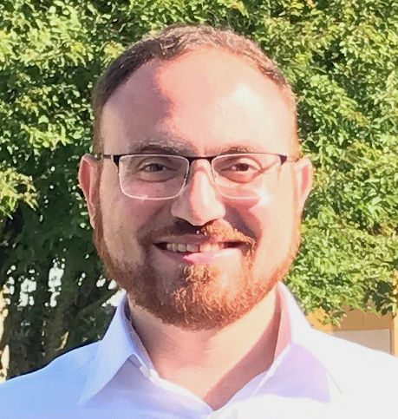

TAs
Beshr Al Nahas
beshr
Charalampos (Babis)
Stylianopoulos
chasty
Christos Profentzas
chrpro
Valentin Poirot
poirotv
@chalmers.se
Lab time: Monday 15:15-17:00, Thursday 08:00-9:45
Ask your questions during the lab time!

Slide 3
Lab Introduction
Lab Introduction I (Nov. 2):
Labs overview, tools we use, Lab 1 (1h)
Introduction to RESTful, Python skeleton (1h)
Lab Introduction II (Nov. 9):
Lab 2 introduction
Solution costs
Concurrency in Python
Notes:
Lab intro II will take approx 1h

Slide 4
Labs Presentation

Slide 5
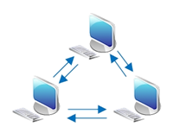
Labs in a nutshell
During the labs you will make this application:
Reliable
Consistent
Efficient
Fault-tolerant
…
Lab overview
You will build an application over this network
Mininet
You will use a platform for emulating computers around the world

Slide 6
Labs in a nutshell
Design and implement a distributed system
RESTful distributed blackboard
Restful (web) Clients send notes to any server
Servers do distributed systems magic to provide a reliable, consistent, efficient, fault-tolerant service
You will learn the required distributed systems magic with Olaf and practice it in the lab exercises

Slide 7
How we will do it
Incremental steps
Explore different design choices:
Lab1 – naïve - make it work ☺
Lab2 – centralized - strong consistency
Lab3 – leaderless - eventual consistency
Lab4 – resilient to malicious servers

Slide 8
The platform: Mininet

Slide 9
Mininet
Network Emulator
Emulate hosts (machines), switches, controllers, and links
On one PC
Used in research
Handles large scale networks

Slide 10
Mininet: How does it work?
Container-based virtualization
Node Emulated as a process on PC
Can not access the other processes locally
But on the Emulated network
Uses the host network stack
OS (Linux)
Mininet Emulation

Slide 11
Mininet: How does it work?
Each simulated machine can be seen as a Linux machine
We can run any program on a simulated machine
shell commands, web browser, …
Every machine = Linux process
OS (Linux)
Mininet Emulation
python script.py

Slide 12
Very Simple Network using
Lightweight Virtualization
Server (or VM!)
Network Namespace 1
Network Namespace 2
firefox
httpd
10.0.0.1
10.0.0.2
eth0
eth0
eth0
veth1
veth2
ovs-vswitchd
Linux Kernel
openvswitch kernel module
Credits: SIGCOMM 2014 tutorial
Notes:
it turns out lightweight virtualization inside heavyweight virtualization is extremely powerful! It enables anyone to run the system irrespective of their client OS (e.g. OS X, Windows) and without additional software installation (besides the hypervisor), and it also allows experiments to be “shrink-wrapped” and shared. For example, there are a number of reproducible research projects using Mininet available as AMIs on EC2.

Slide 13
Mechanism: Network Namespaces and Virtual Ethernet Pairs
Root Namespace
Network Namespace 1
Network Namespace 2
firefox
httpd
10.0.0.1
10.0.0.2
eth0
eth0
eth0
virtual Ethernet pairs
veth1
veth2
Software Switch
Credits: SIGCOMM 2014 tutorial
Notes:
To reiterate, the two key virtualization abstractions that we use in Linux are network namespaces, which virtualize the Linux networking stack (including routing and ARP tables), and virtual ethernet pairs, which are two virtual ethernet interfaces connected by a virtual wire. By default, Mininet models hosts as processes in network namespaces and places the software switches in the root namespace.

Slide 14
Some basic commands
Running tests
pingall
iperf
h1 ping h2
h1 ifconfig
hostname shell_command
Stopping the simulation
exit
You network crashed?
sudo mn -c
Will clear the mininet config files
Might become useful if you try to do your own script!

Slide 15
Mininet example topologies
Run predefined technologies:
sudo mn --topo linear,k=4,n=2
sudo mn --topo tree,depth=3,fanout=2
Use specific parameters
sudo mn -- topo linear, 3 --link tc, bw=10, delay=10ms, jitter=5ms
--link specifies the link attributes
tc uses the TCLink classes, which has modifiable attributes
bw (bandwidth), in Mbps
delay, jitter, must include `ms´!

Slide 16
Some useful links
How to install mininet http://mininet.org/download/
Walkthrough from the basic commands to custom scripts http://mininet.org/walkthrough/
SIGCOMM 2014 tutorial
https://docs.google.com/a/onlab.us/presentation/d/1Xtp05lLQTEFGICTxzV9sQl28wW_cAZz6B1q9_qZBR_8/edit
Some code examples (advanced): https://github.com/mininet/mininet/tree/master/examples

Slide 17
The tools we use here
The software we use in the labs

Slide 18
Qemu: machine emulator and virtualizer
Open source
Mainly through command line
To start the VM:
qemu-system-i386 mininet-vm-i386 -enable-kvm
-m 1G to add more memory
see the prelab to use the mouse

Slide 19
Mininet in Qemu
If you want a desktop, install xinit and lxde
Or just use the X display:
add -redir tcp:2222::22 when launching qemu
from the machine’s terminal, use ssh -Y mininet@localhost -p 2222
You should install Firefox (or anything else) on the VM

Slide 20
Administrative stuff
How to happily pass the course and make us happy

Slide 21
Lab deadlines
Pre-assignment: November 6, 23:59
Lab 1: November 13, 23:59
Demo: Nov. 9 & 13
Lab 2: November 23, 23:59
Demo: Nov. 19 & 23
Lab 3: December 7, 23:59
Demo: Dec. 3 & 7
Lab 4: January 7, 23:59
Demo: Dec. 14
Demo your solution to us before submission
Hard deadlines: Up to 2 weeks late → penalty

Slide 22
Lab logistics
4 Labs x 10 points each = 40 points
Each lab has several tasks
PASS = 31/40 points
Late submissions:
within 1 week after the deadline → -1 point from your score on that lab
within 2 weeks after the deadline → -3 points from your score on that lab
Not accepted after 2 weeks

Slide 23
Hand in
Code
Well structured
Well documented
Results
In a video
2-4 minutes screencast to demonstrate your results
Some screencast software: http://en.wikipedia.org/wiki/Screencast
Screencast software in Lab rooms: RecordMyDesktop
Or in a report (as a pdf file)
Notes:
SAY IN CLASS:
make real a video (no GIF) and ask for voice over
Encourage the students to use diagrams/presentation while explaining the algorithm (which could be handwritten)

Slide 24
Do you favor writing over video?
Include in the report the same information as in the video
That is
Document that your solution works with screenshots and explanations
All stages of the execution should be screenshot and included in your documentation
Notes:
For those who submit a report, it should explain your solution, include justification (be careful about document structure and quality of your document)

Slide 25
Grading
10 points for the mandatory tasks
Solution -4 points
Code structure -2 points
Code documentation -2 points
Report (video or written) -2 points
You need to provide all the parts above
Do not submit code without a video or written report
The points represent the penalty if we do not like something
Bonus tasks give bonus points
Notes:
Say that
-bonus points could be given for “exceptional solutions”

Slide 26
Code Structure and Documentation
“Code is written primarily to be read by humans. It has to be acceptable to the compiler too, but the compiler doesn’t care about how it looks or how well it is written.”
In your professional life, you will mostly use, fix and improve code that exists...

Slide 27
Code Structure and Documentation: Guidelines
Descriptive variable names (‘a’, ‘b’, ‘apa’ are not descriptive…)
Comment blocks of code that are doing something subtle or that is not obvious.
Document what each function does (not how), arguments, returned values, side effects etc. (see Python API).
If you can’t do this in a few sentences …
you may need to rethink your abstraction.

Slide 28
Lab 1
The task – external slides

Slide 29
Questions?

